Slide 1
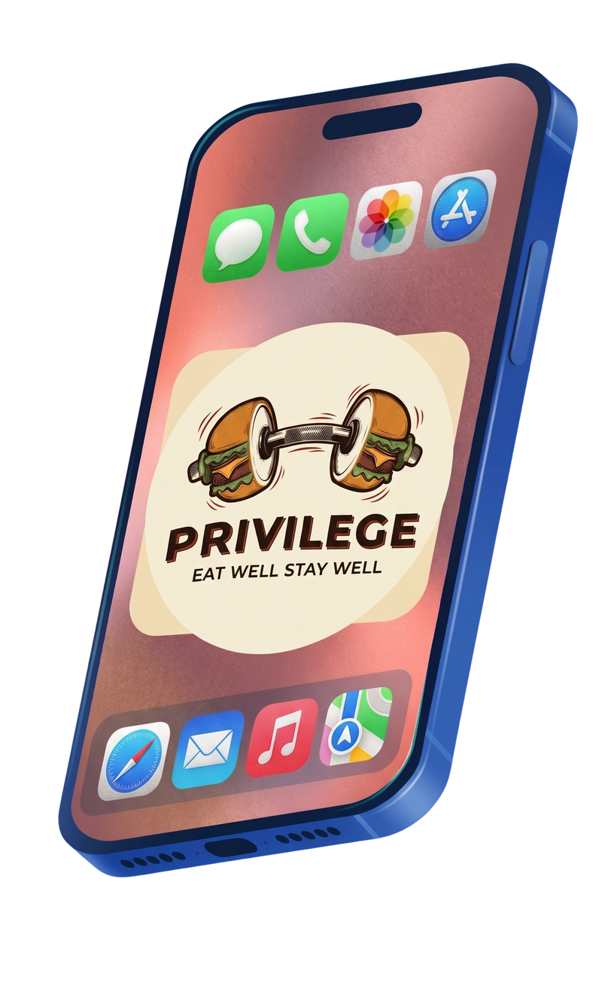
supportprivilegefitness@gmail.com
Privilege
Eat Well ; Stay Well
Project Team :
Ibrahim Mohamed Haggag ( 26104141 )
Hossam Mohamed Ismail ( 26104503)
Abdalla Hithem Alam ( 26103049 )
Ammar Osama Mohammad ( 26103884 )

Slide 2
Project Research
supportprivilegefitness@gmail.com
Efficacy of Fitness AppsResearch published in August 2022 highlights that fitness tracking apps significantly improve user accountability and self-monitoring. As a result, active app users are nearly twice as likely to meet recommended aerobic activity guidelines.
(Reference: Tong, H.L., et al., August 18, 2022, PLOS Digital Health)

Slide 3
Project Research
supportprivilegefitness@gmail.com
A separate December 2022 study revealed that despite proven health benefits, mobile health adoption remains notably low in Egypt, with only 27.4% active usage. Major regional barriers limiting engagement include poor usability, static algorithms, and a severe lack of culturally adapted personalization.
03.
(Reference: Arafa, A., et al., December 9, 2022, Journal of Personalized Medicine)

Slide 4
supportprivilegefitness@gmail.com
Unique Features in Privilege
Building on the insights from the two studies presented earlier, we are excited to introduce our upcoming fitness app project, Privilege.
During our market research, we identified a critical stagnation in the current industry. When examining leading platforms like MyFitnessPal, Strava, and Nike Training Club, we realized that today's fitness apps are fundamentally identical. While they offer different visual layouts, color schemes, and branding, they all recycle the exact same core features—tracking, basic analytics, and generic plans. They differ entirely in aesthetics rather than actual functionality, which is exactly the gap Privilege is designed to fill.
Gamification
AI chat bot
Nutrition
Integeration
Progression
01.
02.
03.
04.
05.
AI delivers intelligent chat assistance, while Gamification drives user motivation through community challenges, streaks, and rewards.Nutrition manages dietary flexibility via a cheat meal organizer, and Integration unifies different athletic activities through sports merging.Progression tracks user development by structuring their fitness journey through distinct, classified achievement levels.

Slide 5
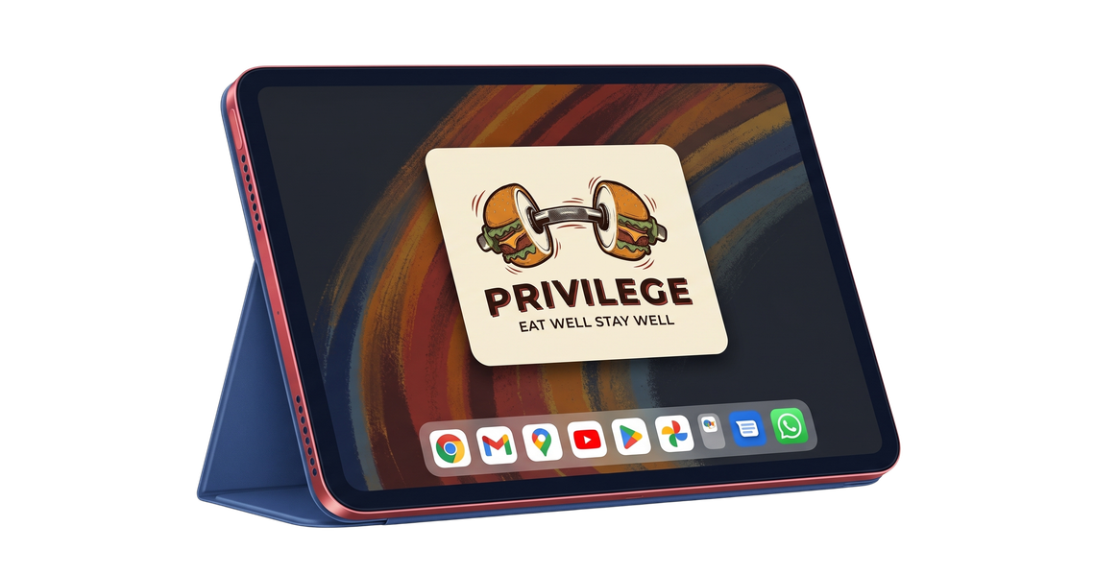
Why Privilege
supportprivilegefitness@gmail.com
While we considered other college project ideas such as a campus event management platform or a peer-tutoring app we ultimately chose Privilege. Our passion for sports gives us a stronger edge in this space, and we believe this concept offers far more potential for integrating unique features.

Slide 6
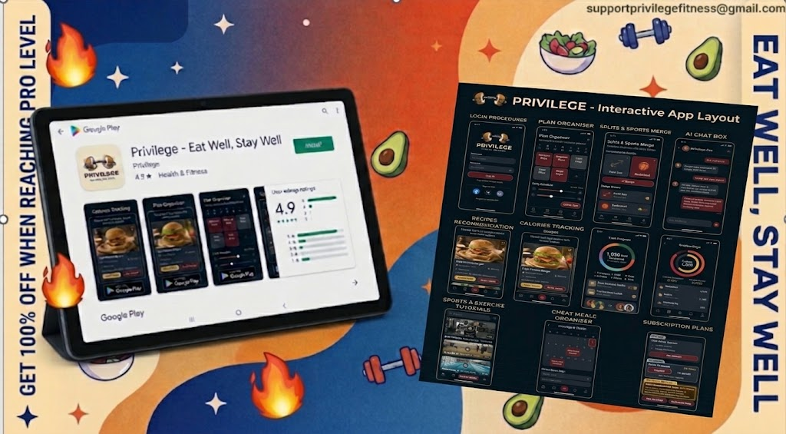
supportprivilegefitness@gmail.com

Slide 7
supportprivilegefitness@gmail.com
Get Ready for Offers !
35%
90 days streakl
Intermidiate level
25%
Train and stay disciplined for 90 days in a row to get 25% off on privilege premium version for 1 month
Train and stay disciplined until you reach intermidiate user level to get 35% off on privilege premium version for 1 month
100%
180 days streakl
Pro level
Train and stay disciplined for 180 days in a row to get 50% off on privilege premium version for 1 month
50%
Train and stay disciplined until you reach pro user level to get 100% off on privilege premium version for one month

Slide 8
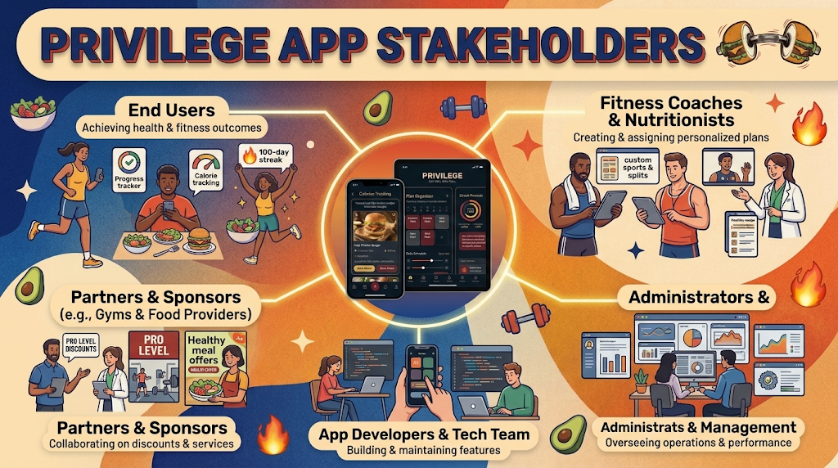
supportprivilegefitness@gmail.com

Slide 9
Thank You
If you have any recommendations or issues, please contact us on supportprivilegefitness@gmail.com
https://ai.studio/apps/13d42522-66a5-4a28-b3d7-461381352df2?fullscreenApplet=true

